Slide 1
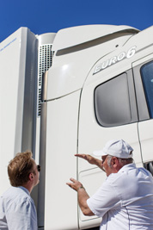
Ecolution by Scania
Ecolution by Scania ties together Scania products and services in a complete solution. It is the very best Scania has to offer in terms of reduced fuel consumption and carbon dioxide emissions. What’s more, Ecolution by Scania is offered with an individually set target and a commitment to reach this target.
Our long-term commitment is to support our business partners through better economic growth, with energy-efficient and profitable solutions tailored to your needs.
Setting the target With the help of our tools we can calculate a target fuel consumption that we and the customer agree to jointly strive to reach. To achieve this target we use the modules within Ecolution by Scania. Each module ensures the lowest possible fuel consumption and CO₂ emissions. The exact content within each module is adapted to your operation but the main modules within Ecolution by Scania are always the same:
Vehicles - Optimised specification
Driver - Scania Driver Training and Scania Driver Follow-up
Service - Maintenance+
We continuously monitor the progress of the Ecolution by Scania vehicle. And each month, the customer receives an Ecolution Report showing the fuel consumption and CO₂ emissions performance in relation to the target.
In a nutshell, Ecolution by Scania can be viewed as two sides of a coin – good fuel economy and low CO₂ emissions.

Slide 2
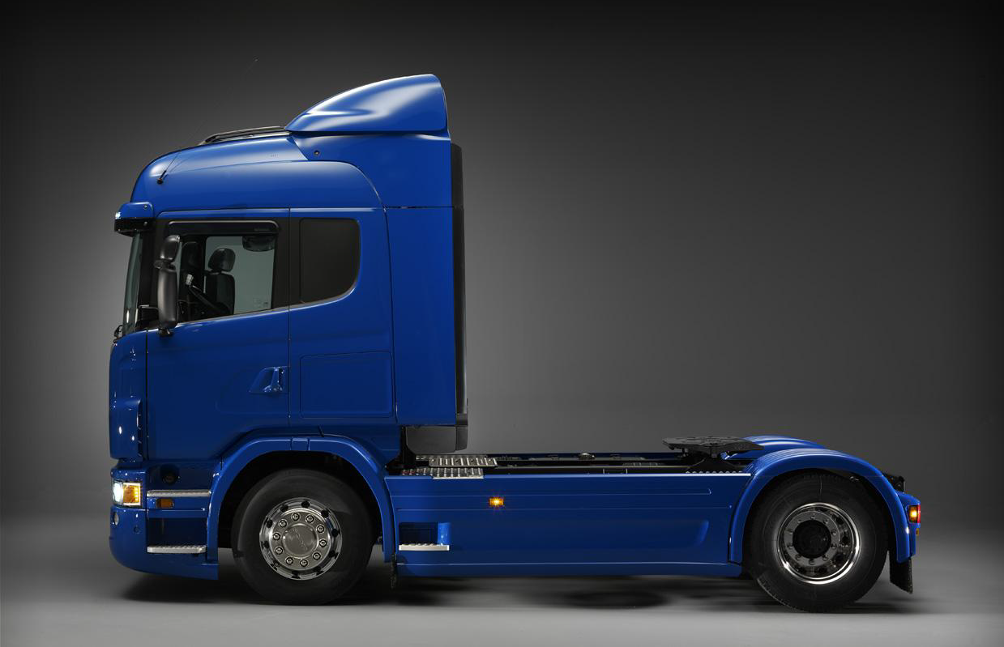
Roof and side air deflectors
7%
Extra Equipment
1.5%
Side air deflectors extension
0.5%
Vehicle Speed, 4 km/h
5%
Vehicle Weight, 500 kg
1%
Powertrain specification
>3%
Scania Opticruise/ Active prediction
5%-8%
Side skirts
1%
Tyre choice
5%

Slide 3
Roof air deflector height adjustment
3%
Axle Alignment, 1
3%
Tyre pressure
1%

